Slide 1
Progressive Web Apps (PWA)
Tobias Hennig
@HennigTobias

Slide 2


Slide 3



https://about.twitter.com/en_us/company/brand-resources.html
https://tinder.com
https://business.pinterest.com/en/pinterest-brand-guidelines

Slide 4

"Progressive Web Apps are fast, robust, app-like experiences built using Service Workers and other modern web capabilities"
Alex Russell, Chrome Dev Summit 2015

Slide 5
PWA
HTTPS
Responsive
Offline
Manifest
Notes:
https://infrequently.org/2016/09/what-exactly-makes-something-a-progressive-web-app/
https://developers.google.com/web/progressive-web-apps/checklist

Slide 6
Motivation

Slide 7

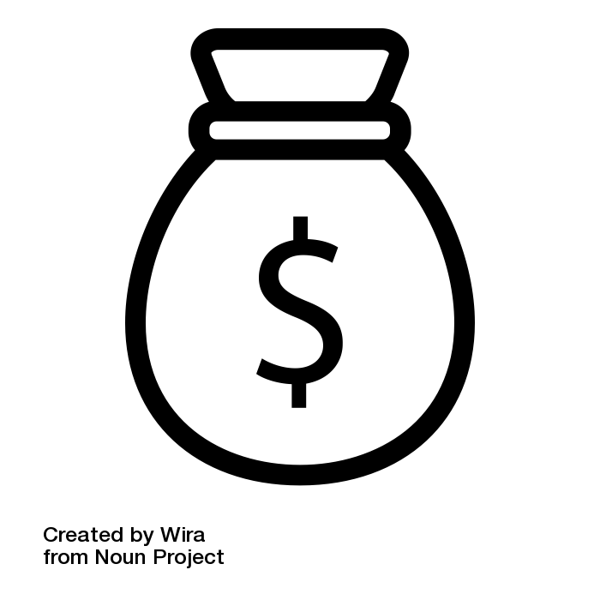

https://thenounproject.com/term/performance/885483/
https://thenounproject.com/term/happy-man/53700/
https://thenounproject.com/wirawizinda097/collection/money/?i=1542361

Slide 8
Workflow

Slide 9
Measure
Group
Easy Stuff
Measure
Hard Stuff
Measure
Notes:
https://infrequently.org/2016/09/what-exactly-makes-something-a-progressive-web-app/
https://developers.google.com/web/progressive-web-apps/checklist

Slide 10
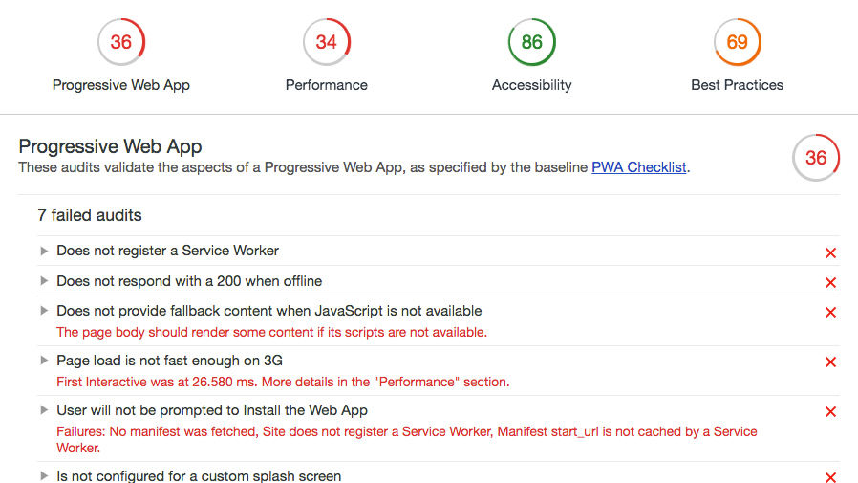

Slide 11

45/100
https://developers.google.com/web/progressive-web-apps/images/pwa-lighthouse.png

Slide 12
Passed (5/11)
Contains some content when JavaScript is not available
Uses HTTPS
Redirects HTTP traffic to HTTPS
Has a <meta name="viewport"> tag with width or initial-scale
Content Sized Correctly for Viewport

Slide 13
Failed (6/11)
User will not be prompted to Install the Web App
Is not configured for a custom splash screen
Address bar does not match brand colors
Does not register a Service Worker
Does not respond with a 200 when offline
Page load is not fast enough on 3G
Notes:
Group

Slide 14
Web App Manifest

Slide 15
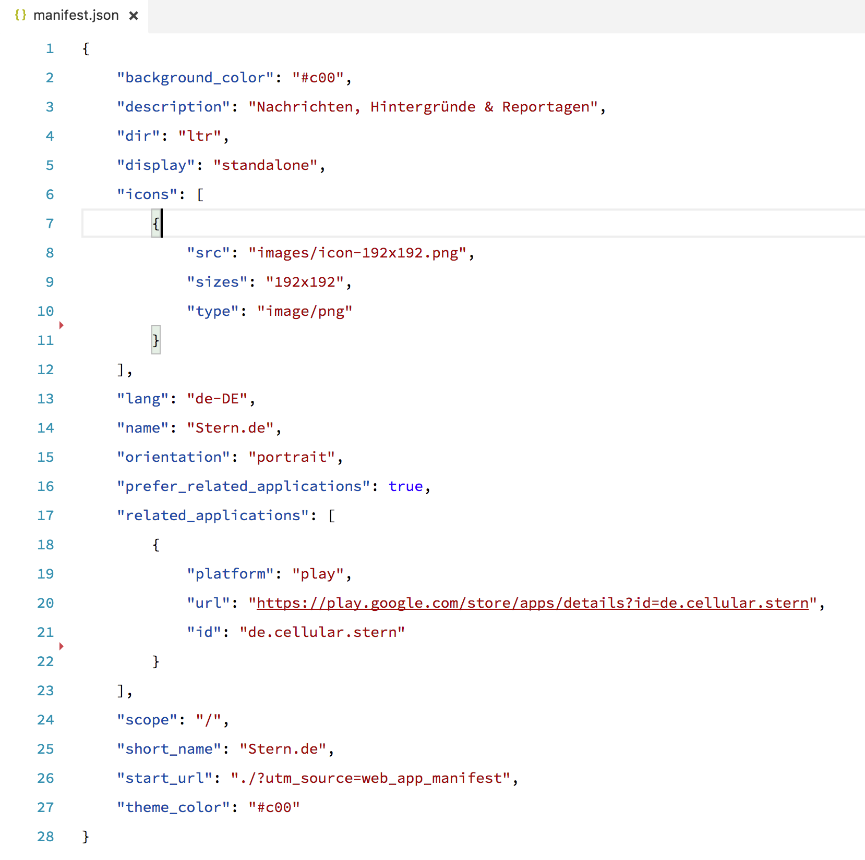

Slide 17




Shipped
In Development
Shipped
Shipped
https://github.com/alrra/browser-logos
Notes:
Web App Manifest Support
4.2.2018

Slide 18
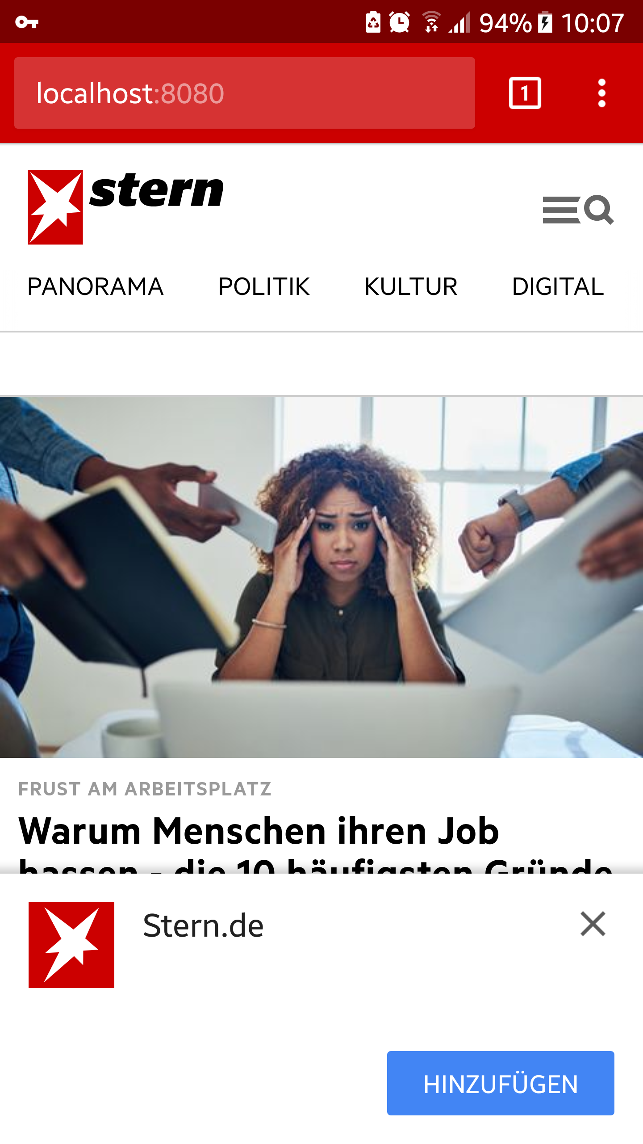
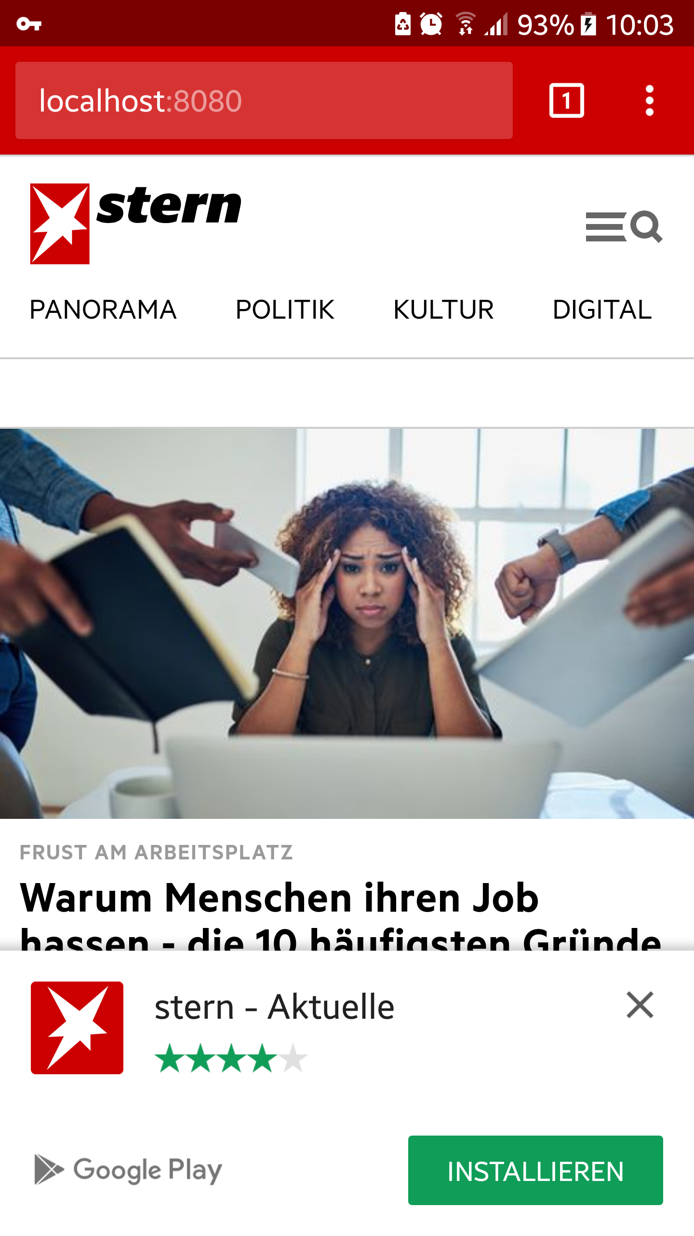
Native add-to-homescreen
Native smart app banner

Slide 19
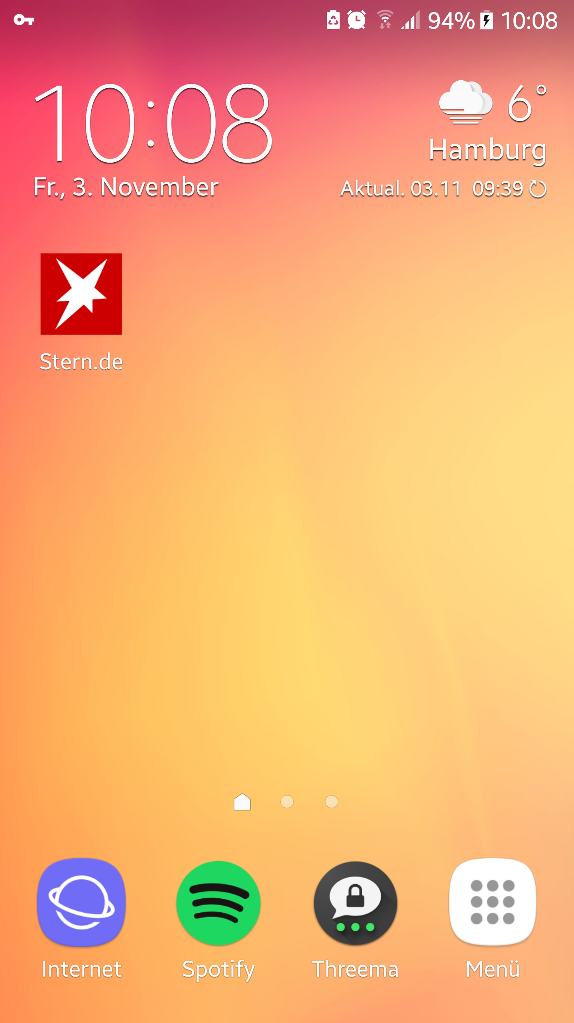
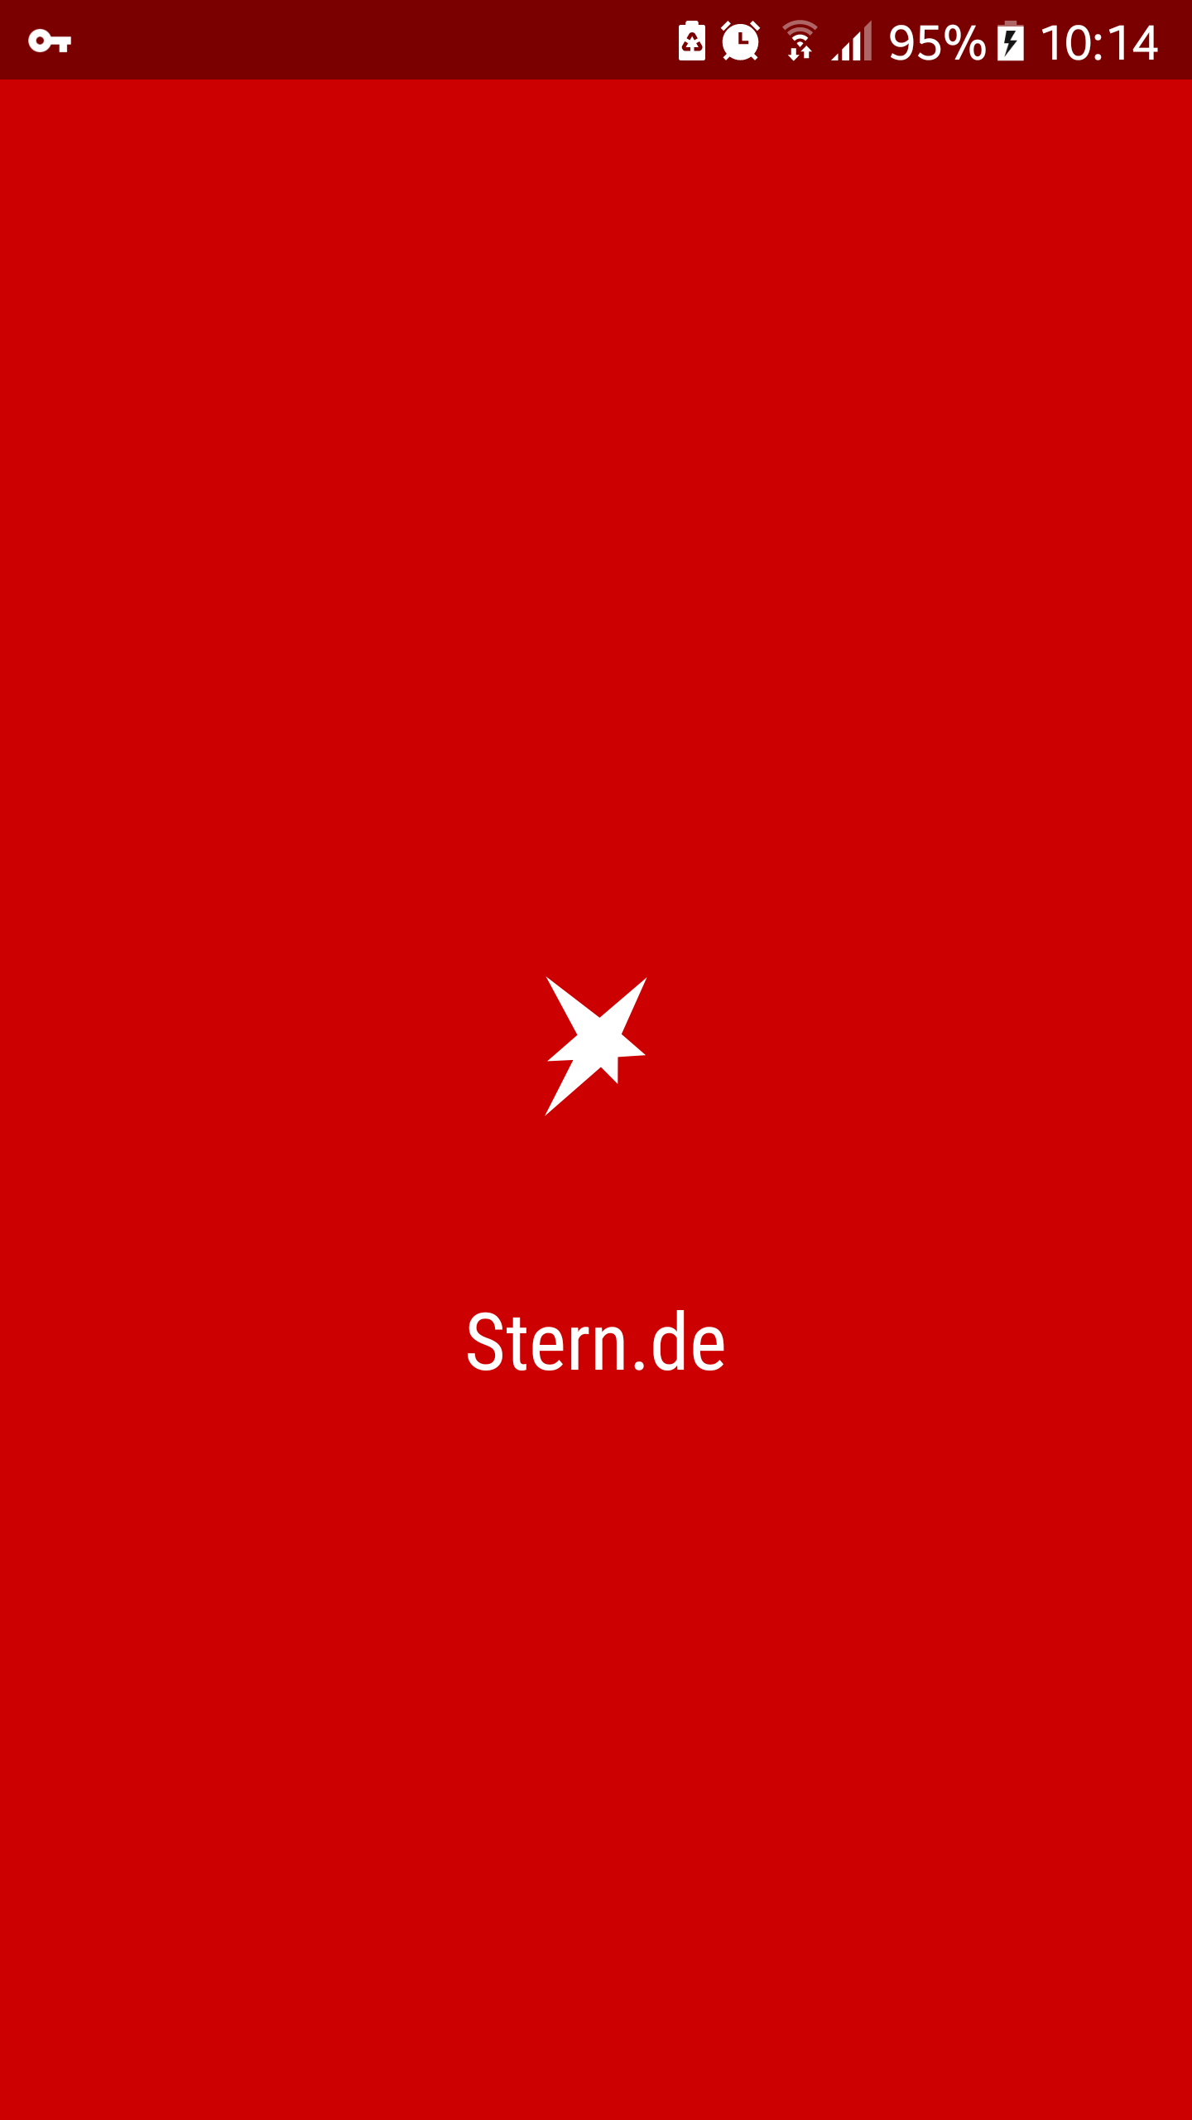
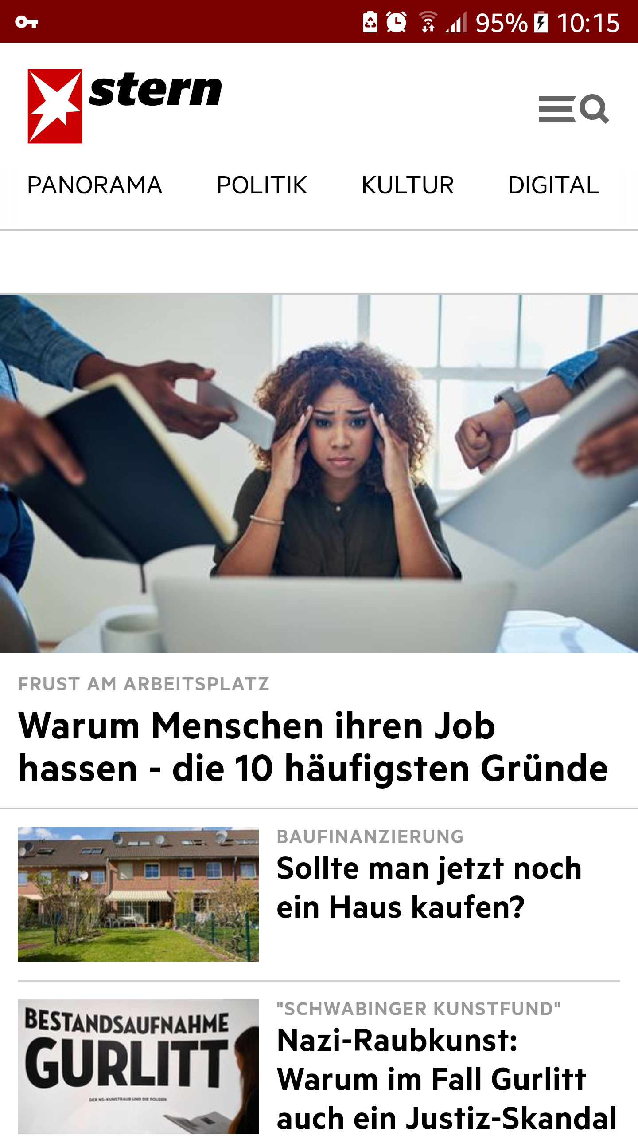
App icon
Splashscreen
Standalone display mode

Slide 20
65/100
+20
Notes:
https://developers.google.com/web/progressive-web-apps/images/pwa-lighthouse.png

Slide 21
Service Worker

Slide 22

me : “Service Worker, what are you?”
Service Worker: “I’m a programmable network proxy.”
me : “… what?”
Mariko Kosaka

Slide 23
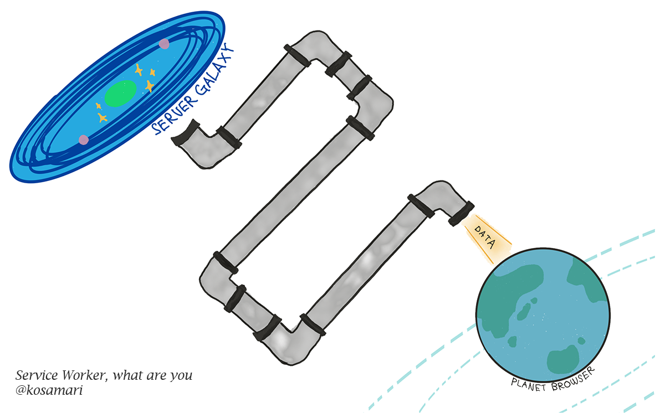
Notes:
The Web

Slide 24
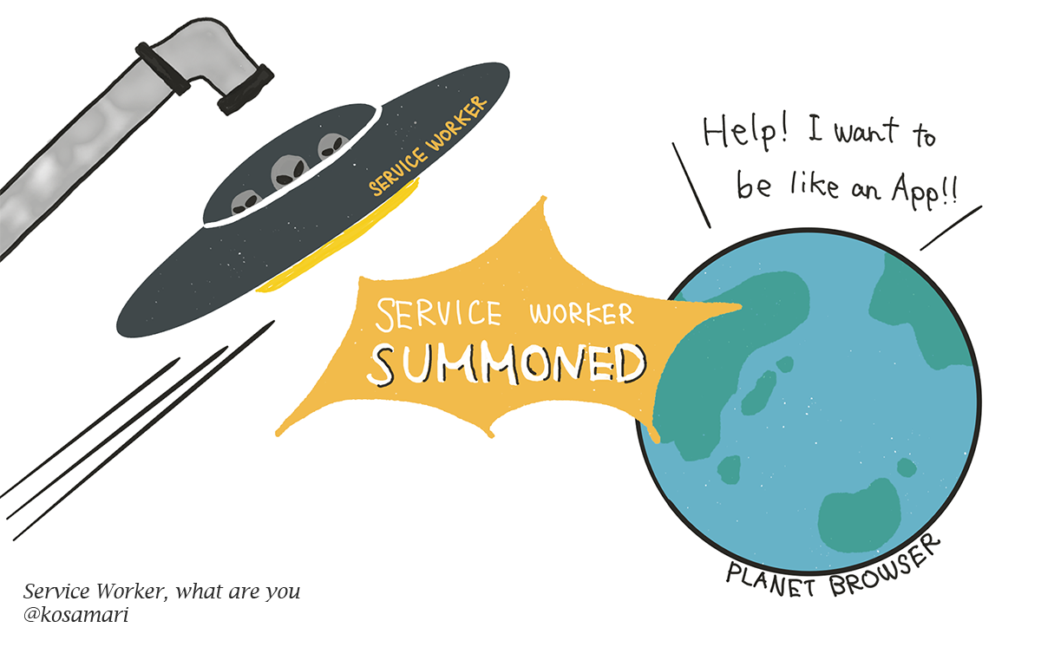
Notes:
The Web with Service Worker

Slide 25
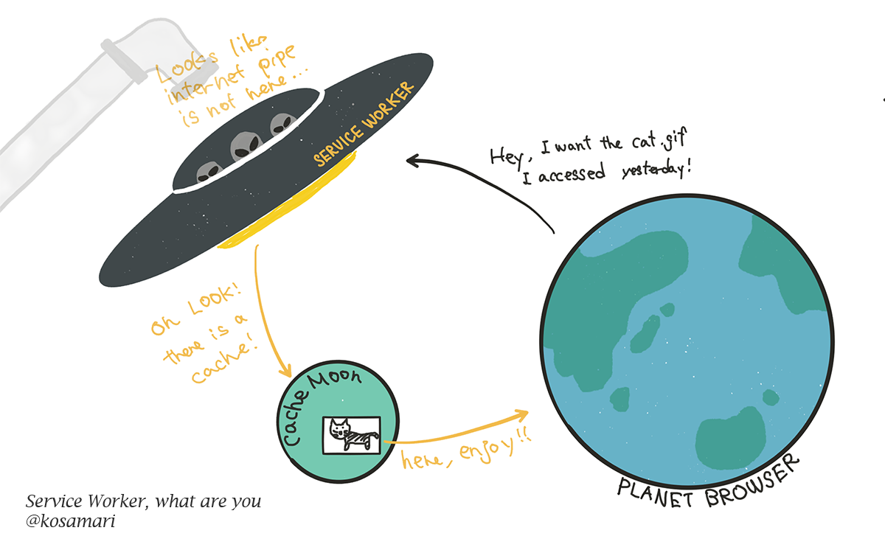
Notes:
SW use case #1: Cache

Slide 26
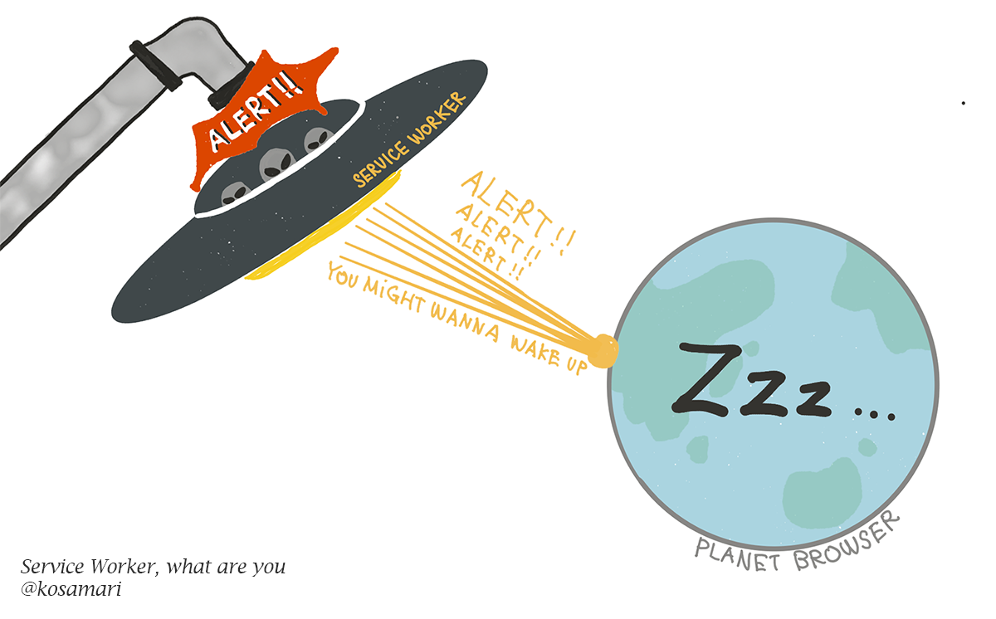
Notes:
SW use case #2: Push notifications

Slide 27

Shipped
Shipped
Shipped
Shipped
https://github.com/alrra/browser-logos
Notes:
Service Worker Support
4.2.2018

Slide 28
With great power,
Comes great responsibility
complexity

Slide 29

Notes:
https://developers.google.com/web/tools/workbox/thumb.png

Slide 30
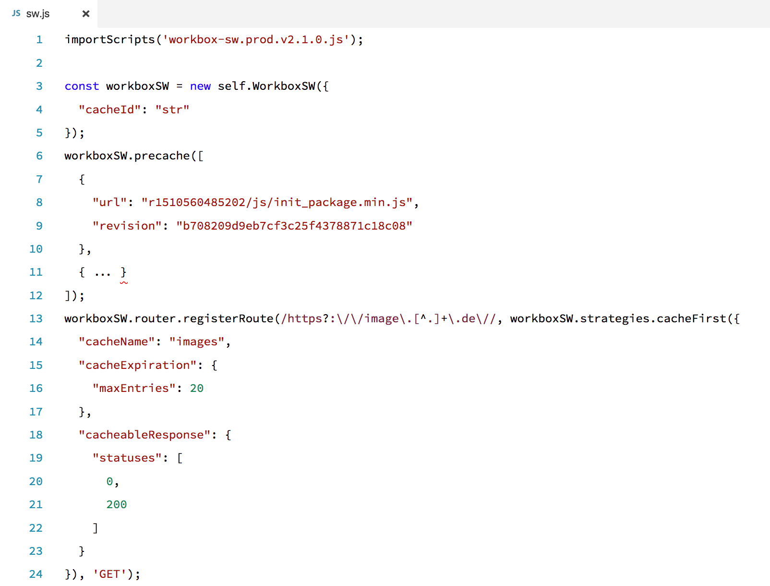
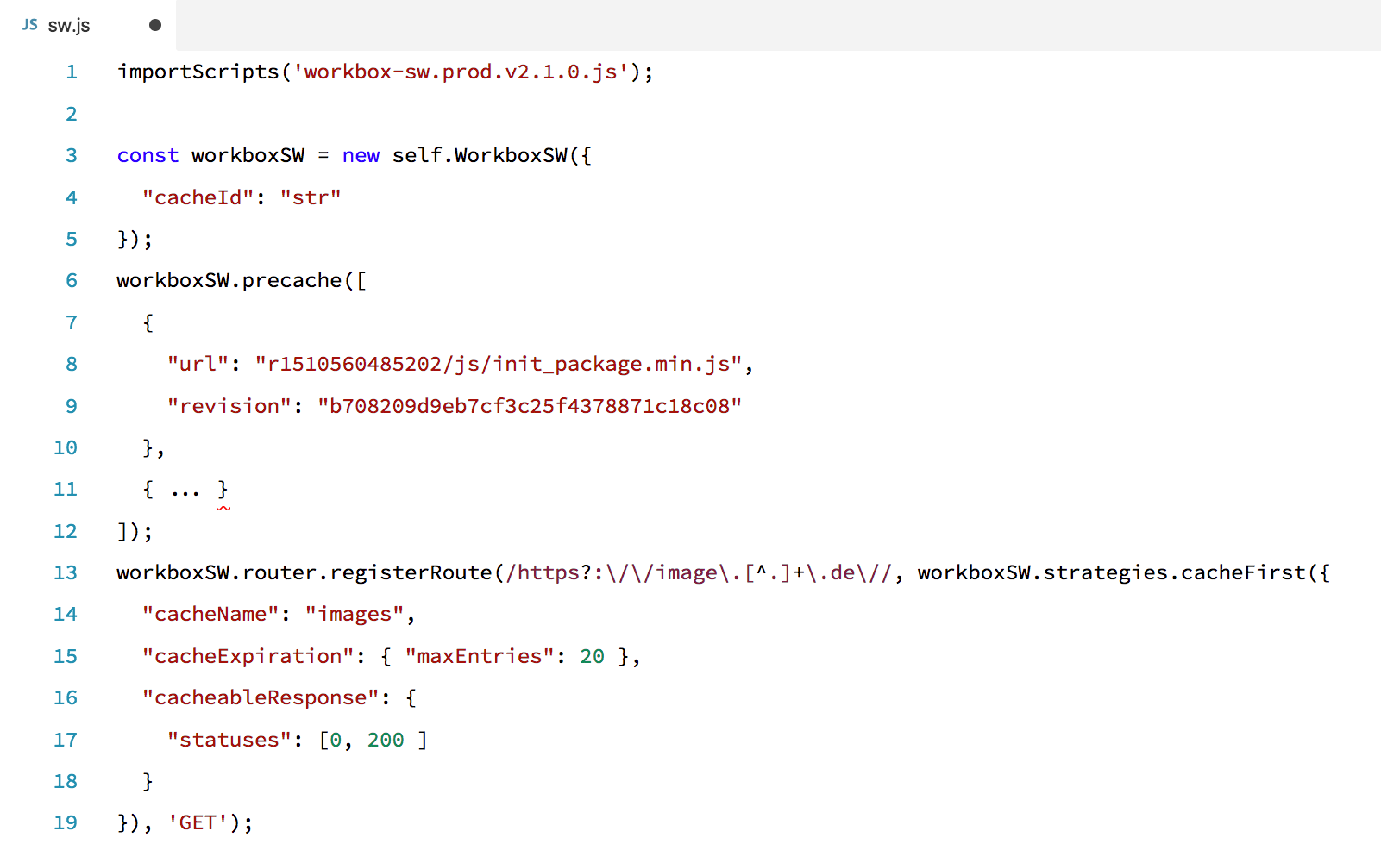

Slide 31
...later

Slide 32

https://unsplash.com/photos/IClZBVw5W5A

Slide 33
91/100
+26
https://developers.google.com/web/progressive-web-apps/images/pwa-lighthouse.png

Slide 34
Passed (10/11)
...
User can be prompted to Install the Web App
Configured for a custom splash screen
Address bar matches brand colors
Register a Service Worker
Responds with a 200 when offline
Notes:
https://giphy.com/joker_eckesgranini/

Slide 35
Failed (1/11)
Page load is not fast enough on 3G
Notes:
Group

Slide 36
Challenges

Slide 37


2
https://thenounproject.com/term/performance/885483/
https://thenounproject.com/search/?q=offline&i=821504

Slide 38
Questions

Slide 39
Links

Slide 40
https://de.udacity.com/course/intro-to-progressive-web-apps--ud811
https://de.udacity.com/course/offline-web-applications--ud899
https://developers.google.com/web/ilt/pwa/
https://jakearchibald.com/2014/offline-cookbook/
https://serviceworke.rs/
https://github.com/hemanth/awesome-pwa

